Slide 1
Prediction Challenge 3
Ali Awari

Slide 2
Finding Predictors From the Dataset

Slide 3
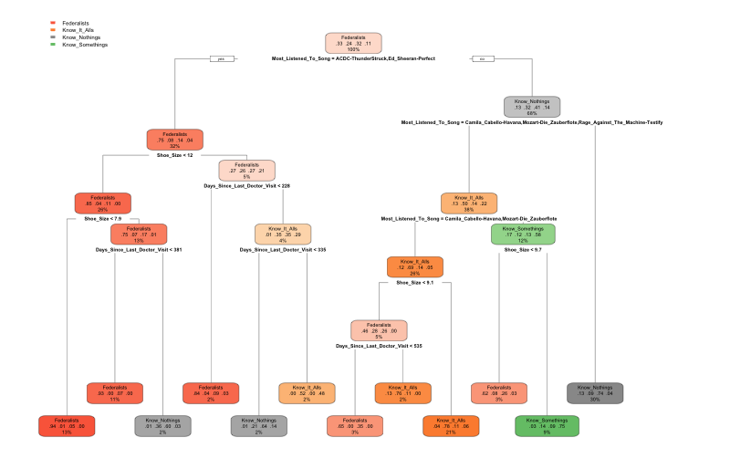
Testing all values
Using all the vars. creates the tree shown above.
Most Listened To Song, Shoe Size, and Days Since Last Doctor Visit are promising variables to use.

Slide 4
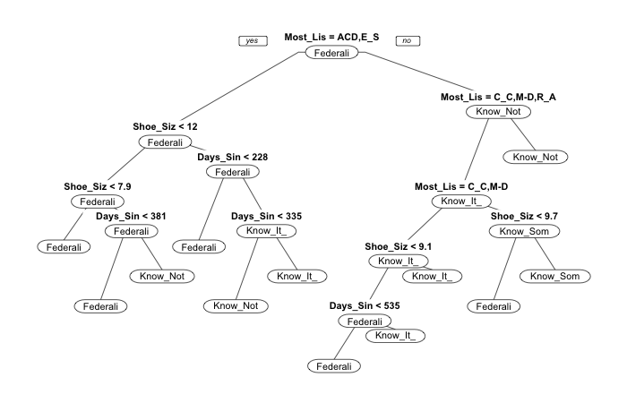
Red Herring
Average Accuracy Subset: 0.79. It turns out that: Most Listened To Song, does not provide enough gain to the accuracy to include it into the tree.
tree <- rpart(Party ~ Most_Listened_To_Song + Shoe_Size + Days_Since_Last_Doctor_Visit, data = train, control = rpart.control(minsplit = 60))
prp(tree, type = 1)
cross_validate(train, tree, 10, 0.8)

Slide 5
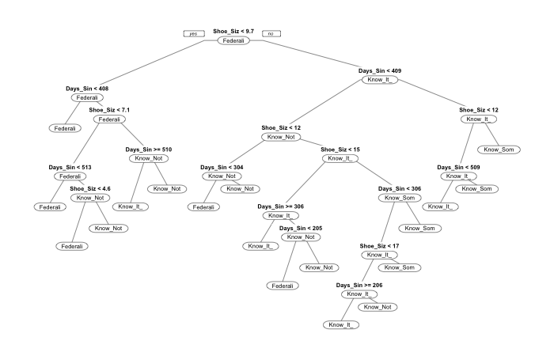
Create a new tree
Removing music provides a way higher average!
0.95375
tree <- rpart(Party ~ Days_Since_Last_Doctor_Visit + Shoe_Size, data = train, control = rpart.control(minsplit = 60))
prp(tree, type = 1)

Slide 6
Conclusion
Not all trees that r-part creates will be useful to you if it doesn’t improve your accuracy.
You need to be able to distinguish different variables from one another and locate patterns.

